Slide 1
FORD ECONOLINE E-450 CUTAWAY
HARDWARE MOUNTING AND CABLE GUIDE
HEAVY DUTY VEHICLE (U.S.)

Slide 2
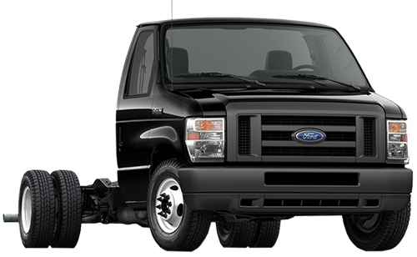
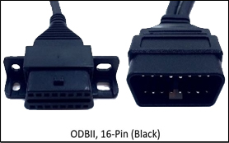
Ford Econoline Cutaway
Cable Guide
Year Range | SR4 Harness Description | SR4 SKU | Cable Type
1996-2020 | ODBII 16-pin black | 104-0009-0013-00
Ford Econoline E-450
(Flat Windshield)

Slide 3
Ford Econoline Cutaway (all years)
Approved camera mounting (flat/split windshield), sensor bar, and keypad locations
Note: Any combination of these mounting locations are approved
Flat windshield - Preferred locations
Flat windshield - Alternative locations
Cab Cam
Left of Forward Cam
Forward Cam
center windshield
Forward Cam
center windshield
Cab Cam
Right of Forward Cam
Sensor Bar
Middle A-pillar
Sensor Bar
Bottom A-pillar
Sensor Bar
Bottom A-pillar
Keypad
Right of steering wheel
Keypad
Left of steering wheel

Slide 4
Ford Econoline E-450 Cutaway
2013-2020 Approved controller, ECU, and wiring locations
Primary
+12v Constant
1
1
1
Component | Primary location
Controller | Driver-side Behind instrument panel
ECU Port | Driver-side ODBII, 16-pin black (104-0009-0013-00)
Wiring Constant Power | Driver-side Positive (Hot) side of the battery Engine compartment
Wiring True Ignition | Driver-side Fuse Box left of steering wheel
Wiring Ground | Driver-side On chassis near fuse box
BATTERY
FUSE
BOX
(Chassis)
Ground
+12v True Ignition

Slide 5
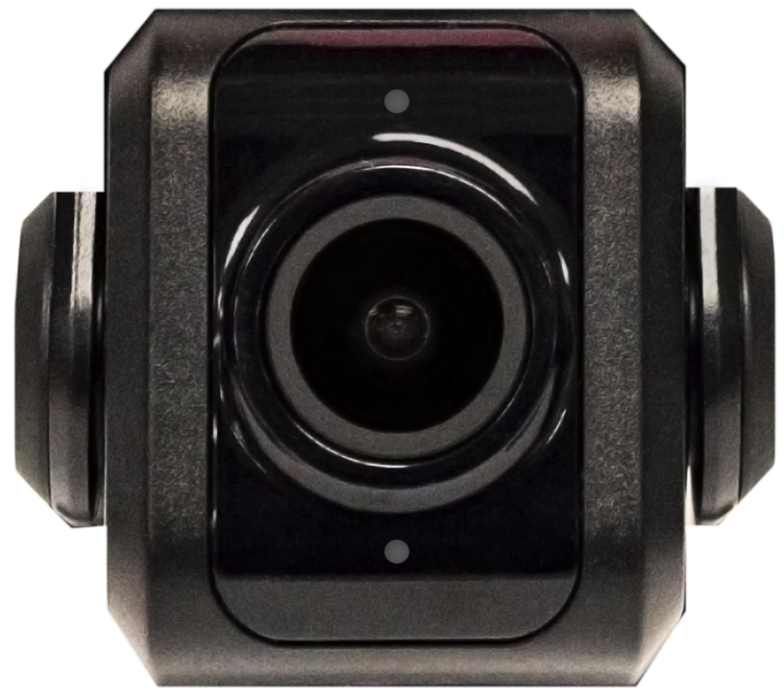
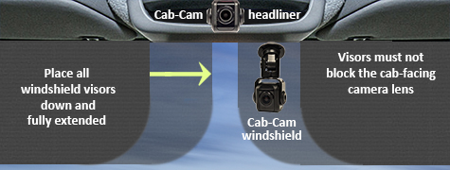
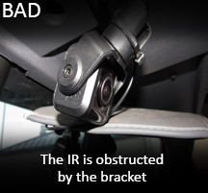
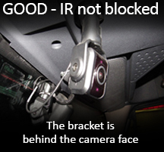
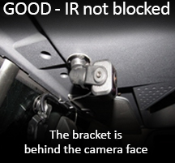
Key Compliance Specifications
Forward-facing Camera
Mount the camera within 6" from the top of the windshield.
Camera cannot interfere with a driver’s line of sight
to the road, traffic signals, or road signs
Cab-facing Camera
Camera lens must have a complete view of the driver when the visors are in the down and fully extended position. Use a headliner location
when the fully extended visor covers the camera lens.
Make sure the cab-facing camera bracket, or vehicle's headliner, DOES NOT BLOCK the cameras Infrared (IR) sensors
Top Infrared Sensor
Bottom Infrared Sensor
Infrared Sensor is obstructed by the bracket

Slide 6
Key Compliance Specifications
Master Power Cutoff (MPC) and Low Voltage Disconnect (LVD)
Connect the SmartRecorders Red Constant Power wire to the Positive Post of the Vehicles Battery.
Connect the SmartRecorders Red Constant Power wire to the Hot/Battery side of the Master Power Cut-off switch.
Connect the SmartRecorders Red Constant Power wire to the Hot/Battery of side the Low Voltage Disconnect.
The SmartDrive SR4 system is designed to function only with a Positive MPC/LVD, not a Negative Ground MPC/LVD.

