Slide 1
MACK
SPEC GUIDE
HEAVY DUTY VEHICLE (U.S.)

Slide 2
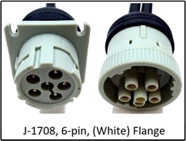
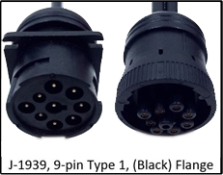
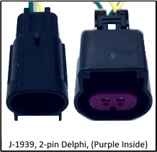
Mack
Cable Guide
Year Range | SR4 Harness Description | SR4 SKU | Cable Type
1996-2002 | J-1708, 6 Pin White flange | 104-0009-0011-01
2003-2012 | J1708 & J1939 9 Pin Type 1 Black flange | 104-0009-0018-00
2013 (1st choice) | J-1939, 2 Pin Delphi purple inside | 104-0009-0009-00
Anthem
(Flat windshield)

Slide 3
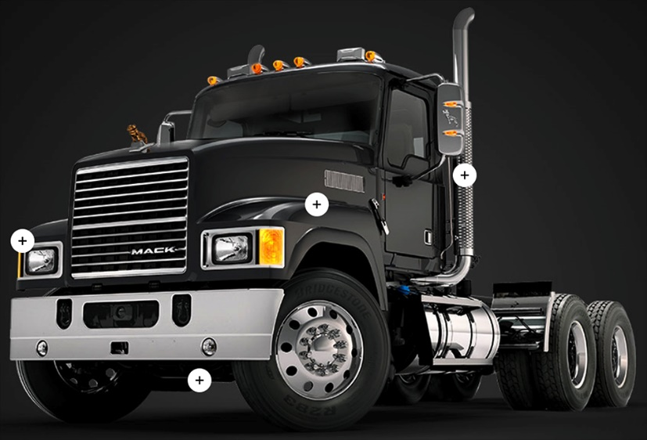
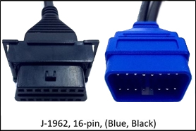
Mack
Cable Guide
Year Range | SR4 Harness Description | SR4 SKU | Cable Type
2013 (2nd choice) | J1708 & J1939 9 Pin Type 1 Black flange | 104-0009-0018-00
2014-2016 (1st choice) | J-1939, 2 Pin Delphi purple inside | 104-0009-0009-00
2014-2016 (2nd choice) | J-1962, 16 Pin Type A black/blue | 104-0009-0012-00
Pinnacle
(Flat windshield)
Granite
(Split windshield)

Slide 4
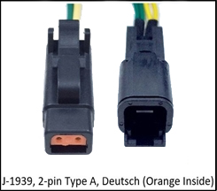
Mack
Cable Guide
Year Range | SR4 Harness Description | SR4 SKU | Cable Type
2017-2018 (1st choice) | J-1939, 2 Pin Type A Deutsch orange inside | 104-0009-0007-00
2017-2018 (2nd choice) | J-1939, 2 Pin Delphi purple inside | 104-0009-0009-00
2019 Anthem Only | J-1939, 2 Pin Type A Deutsch orange inside | 104-0009-0007-00
TerraPro
(Split windshield)

Slide 5
Mack (all years)
Approved camera mounting (flat/split windshield), sensor bar, and keypad locations
Note: Any combination of these mounting locations are approved
Flat windshield - Preferred locations
Flat windshield - Alternative locations
Cab Cam
Center headliner
Forward Cam
center windshield
Cab Cam
Right of Forward Cam
Sensor Bar
Middle A-pillar
Forward Cam
center windshield
Sensor Bar
Bottom A-pillar
Sensor Bar
Bottom A-pillar
Keypad
Right of steering wheel
Keypad
Left of steering wheel
Split windshield - Preferred locations
Split windshield - Alternative locations
Cab Cam
Center headliner
Forward Cam
Right of split
Cab Cam
Right of Forward Cam
Sensor Bar
Middle A-pillar
Forward Cam
Right of split
Sensor Bar
Bottom A-pillar
Sensor Bar
Bottom A-pillar
Keypad
Right of steering wheel
Keypad
Left of steering wheel

Slide 6
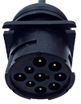
Mack Granite GU513/GU813 (2012-2018)
Approved controller, ECU, and wiring locations
Primary
+12v Constant
+12v True Ignition
(Chassis) Ground
1
1
1
Component | Primary location
Controller | Center Dash
ECU Port | Driver-side 9-pin, Type 1, Flange (104-0009-0018-00)
Wiring Constant, True Ignition, & Ground | Center Console Fuse Panel
FUSE
BOX

Slide 7
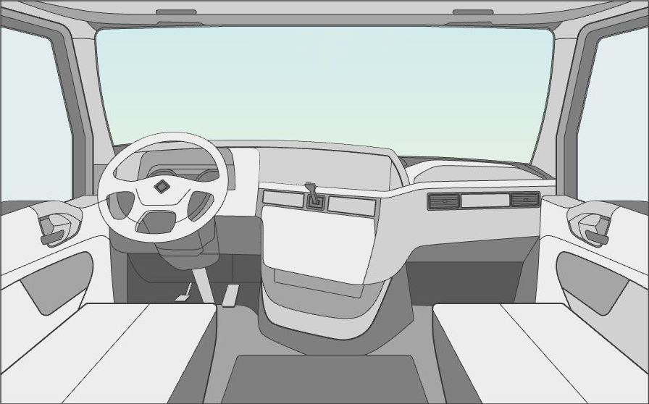
Mack Anthem Series (2012-2019)
Approved controller, ECU, and wiring locations
Primary
+12v Constant
+12v True Ignition
(Chassis) Ground
1
1
1
2
Component | Primary location | Secondary location
Controller | Center Dash | Same
ECU Port | 2012-2018 Driver-side 9-pin, Type 1, Flange (104-0009-0018-00) | 2019-present Next to fuse box J-1939, 2 Pin Delphi purple inside
Wiring Constant, True Ignition, & Ground | Center Console Fuse box | Same
FUSE
BOX
2

Slide 8
Mack Pinnacle CXU613 (2014-2018)
Approved controller, ECU, and wiring locations
+12v Constant
+12v True Ignition
(Chassis) Ground
1
Component | Primary location
Controller | Driver-side, behind instrument panel
ECU Port | Next to fuse box J-1939, 2 Pin Delphi (purple inside) 104-0009-0009-00
Wiring Constant, True Ignition, & Ground | Center Console Fuse box
FUSE
BOX
Primary
1
1

Slide 9
Mack TerraPro - MRU613 (2003-2018)
Approved controller, ECU, and wiring locations
2014-2018
2003-2013
2
2
1
1
1
2
Component | Primary location | Secondary location
Controller | Under Dash Left of steering column | Same
ECU Port | 2014-2018 Next to fuse box J-1939, 2 Pin Delphi (purple inside) 104-0009-0009-00 | 2003-2013 Driver-side, under dash J-1939, 9 Pin Type 1, Flange black 104-0009-0018-00
Wiring Constant, True Ignition, & Ground | Center Console Fuse box right of the driver’s seat | Same
+12v Constant
+12v True Ignition
(Chassis) Ground
FUSE
BOX
CENTER CONSOLE

Slide 10
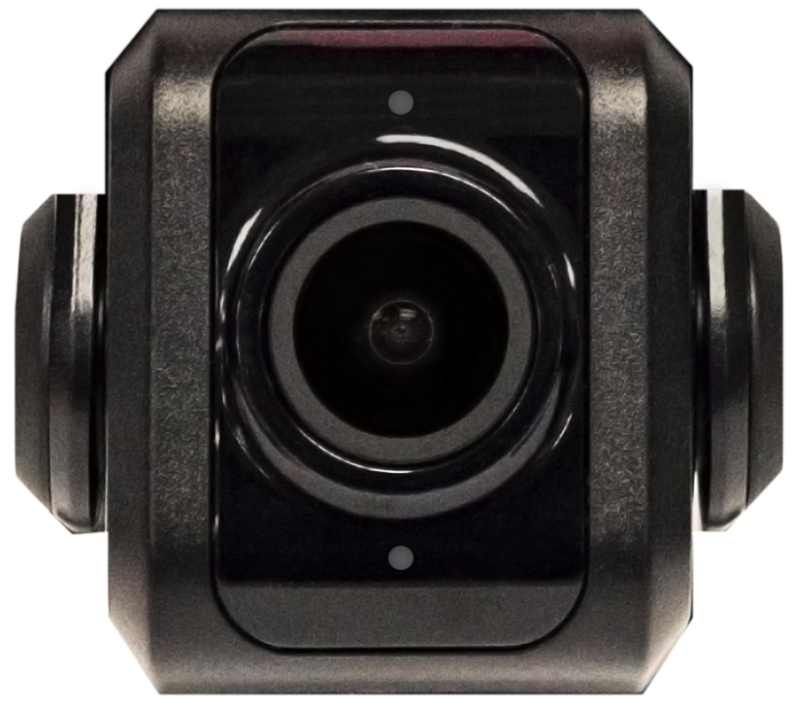
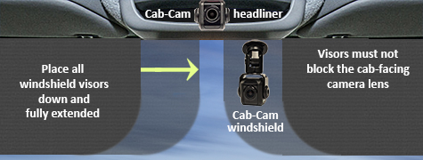
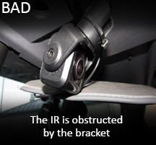
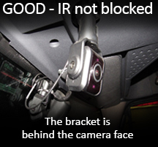
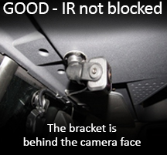
Key Compliance Specifications
Forward-facing Camera
Mount the camera within 6" from the top of the windshield.
Camera cannot interfere with a driver’s line of sight
to the road, traffic signals, or road signs
Cab-facing Camera
Camera lens must have a complete view of the driver when the visors are in the down and fully extended position. Use a headliner location
when the fully extended visor covers the camera lens.
Make sure the cab-facing camera bracket, or vehicle's headliner, DOES NOT BLOCK the cameras Infrared (IR) sensors
Top Infrared Sensor
Bottom Infrared Sensor
Infrared Sensor is obstructed by the bracket

Slide 11
Key Compliance Specifications
Master Power Cutoff (MPC) and Low Voltage Disconnect (LVD)
Connect the SmartRecorders Red Constant Power wire to the Positive Post of the Vehicles Battery.
Connect the SmartRecorders Red Constant Power wire to the Hot/Battery side of the Master Power Cut-off switch.
Connect the SmartRecorders Red Constant Power wire to the Hot/Battery of side the Low Voltage Disconnect.
The SmartDrive SR4 system is designed to function only with a Positive MPC/LVD, not a Negative Ground MPC/LVD.

