Slide 1
International DuraStar
Manufactured 2001-2019. Replaced by International MV Series
SPEC GUIDE HEAVY DUTY VEHICLE (U.S.)

Slide 2
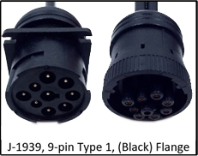
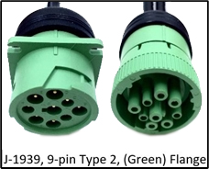
International DuraStar
Cable Guide
Year Range | SR4 Harness Description | SR4 SKU | Cable Type
2001-2016 Released 2001 | J-1939 and J1708 9 Pin Type 1, Black flange | 104-0009-0018-00
2017-2019 Last year 2018 | J-1939, 9 Pin Type 2, Green Flange | 104-0009-0005-00
Durastar
(Flat windshield)
Produced 2001-2019
Replaced by International MV Series

Slide 3
International DuraStar (2001-2019)
Approved camera mounting (flat/split windshield), sensor bar, and keypad locations
Note: Any combination of these mounting locations are approved
Flat windshield - Preferred locations
Flat windshield - Alternative locations
Cab Cam
Center headliner
Forward Cam
center windshield
Cab Cam
Right of Forward Cam
Sensor Bar
Middle A-pillar
Forward Cam
center windshield
Sensor Bar
Bottom A-pillar
Sensor Bar
Bottom A-pillar
Keypad
Right of steering wheel
Keypad
Left of steering wheel
Split windshield - Preferred locations
Split windshield - Alternative locations
Cab Cam
Center headliner
Forward Cam
Right of split
Cab Cam
Right of Forward Cam
Sensor Bar
Middle A-pillar
Forward Cam
Right of split
Sensor Bar
Bottom A-pillar
Sensor Bar
Bottom A-pillar
Keypad
Right of steering wheel
Keypad
Left of steering wheel

Slide 4
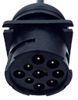
International DuraStar 2001-2016
Primary
+12v Constant
+12v True Ignition
(Chassis) Ground
1
1
1
Component | Primary location
Controller | Center console below dash
ECU Port | Driver-side bottom dash J1708 & J1939 9 Pin Type 1, Flange black (104-0009-0018-00)
Wiring Constant, True Ignition, & Ground | Passenger-side Fuse Box
FUSE
BOX

Slide 5
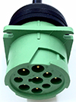
International DuraStar (2017-2019)
Primary
+12v Constant
+12v True Ignition
(Chassis) Ground
1
1
1
Component | Primary location
Controller | Center console below dash
ECU Port | Driver-side bottom dash J-1939, 9 Pin Type 2, Flange green (104-0009-0005-00)
Wiring Constant, True Ignition, & Ground | Passenger-side Fuse Box
FUSE
BOX

Slide 6
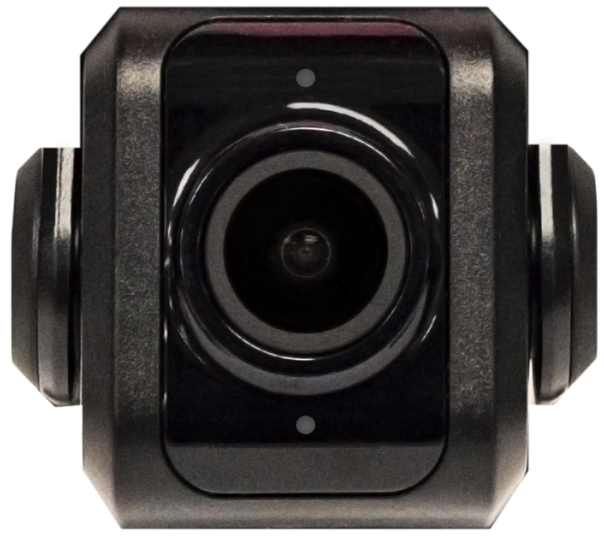
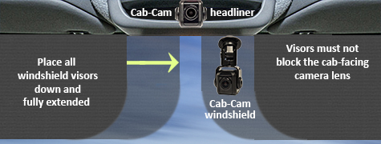
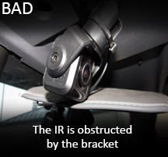
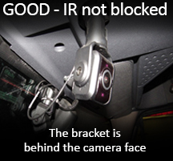
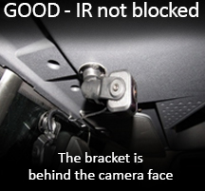
Key Compliance Specifications
Forward-facing Camera
Mount the camera within 6" from the top of the windshield.
Camera cannot interfere with a driver’s line of sight
to the road, traffic signals, or road signs
Cab-facing Camera
Camera lens must have a complete view of the driver when the visors are in the down and fully extended position. Use a headliner location
when the fully extended visor covers the camera lens.
Make sure the cab-facing camera bracket, or vehicle's headliner, DOES NOT BLOCK the cameras Infrared (IR) sensors
Top Infrared Sensor
Bottom Infrared Sensor
Infrared Sensor is obstructed by the bracket

Slide 7
Key Compliance Specifications
Master Power Cutoff (MPC) and Low Voltage Disconnect (LVD)
Connect the SmartRecorders Red Constant Power wire to the Positive Post of the Vehicles Battery.
Connect the SmartRecorders Red Constant Power wire to the Hot/Battery side of the Master Power Cut-off switch.
Connect the SmartRecorders Red Constant Power wire to the Hot/Battery of side the Low Voltage Disconnect.
The SmartDrive SR4 system is designed to function only with a Positive MPC/LVD, not a Negative Ground MPC/LVD.

