Slide 1
09/03/2020
New Hours of Service Rules

Slide 2
ES Hours of Service Releases – September
1 | New Hours of Service
2 | Host Changes
3 | Mobile Changes
4 | Host Changes

Slide 3
ES Hours of Service
FMCSA New Hours of
Service Rules

Slide 4
FMCSA Changes on all releases
Changes Impact ES Rules Engine for Sleeper Berth, Passenger Rule and Rest Break
Several updates have been made in preparation for revised FMCSA Hours of Service rules that will take effect on September 29, 2020 at 12:01 am.
The rules have been updated to allow greater flexibility for drivers without affecting their safety.
You can see the final rule on the FMCSA website
https://www.federalregister.gov/documents/2020/06/01/2020-11469/hours-of-service-of-drivers
The changes should not require any action from drivers, and they will not take effect until the FMCSA changes begin on September 29.

Slide 5
FMCSA Changes Impacting ES Hours of Service
Changes Impact ES Rules Engine for Sleeper Berth, Passenger Rule and Rest Break
The 30-minute break requirement for drivers of property-carrying CMVs in § 395.3(a)(3)(ii) is applicable only when a driver has driven (instead of having been on-duty) for a period of 8 hours without at least a 30-minute non-driving interruption.
The break may be satisfied by any non-driving period of 30 minutes, i.e., on-duty, off-duty, or sleeper berth time.
The sleeper berth requirements were modified to:
(1) Allow drivers to take their required 10 hours off-duty in two periods, provided one off-duty period (whether in or out of the sleeper berth) is at least 2 hours long and the other involves at least 7 consecutive hours spent in the sleeper berth, and
(2) add that neither period counts against the maximum 14-hour driving window in § 395.3(a)(2).
A combination of sleeper berth time of at least 7 consecutive hours and up to 3 hours riding in the passenger seat of the vehicle while the vehicle is moving on the highway, either immediately before or after the sleeper berth time, amounting to at least 10 consecutive hours.

Slide 6
ES Hours of Service
Host Release Dates
August 29, 2020 USA
September 26, 2020 USA & Canada

Slide 7
FMCSA Changes
Host Releases
5.13 Patch that was rolled out on August 29th In the USA. The release Featured Rules Engine features for the New Hours of Service Rules as well as Editing of Manual driving events on the host.
An additional Release for the new Hours of Service rule changes will occur on September 26, 2020 for the USA
Canada will get the Host 5.13 Patch – Manual Driving & 5.13 Hours of Service Rule Changes on September 26, 2020

Slide 8
5.13 – Manual Driving Patch Host
Release Date August 29th USA and September 26th in Canada
Features
Users can now edit manually recorded driving events in a driver's log. To edit an event, simply select the Edit icon next to it. Requires Mobile Firmware Versions IVG DA1007R, MCP 200/110 AA1831R MCP50CA1397 or higher.
New Rules Engine effective only after 12:01 AM on September 29th
Fixes
When users enter an annotation in the Vehicles tab, they no longer receive a pop-up message reminding them of the minimum required number of characters (four) as they are entering the first three characters of their note.
Notes:
This was covered in Outlook HOS Basics

Slide 9
5.13 – New Hours of Service Rules Patch Host
Release Date September 26th in USA & Canada
Features
On the Driver Summary and Details Page, Users can now select Will Pair SB check
(Effective Only after 12:01 AM on September 29th)
Notes:
This was covered in Outlook HOS Basics

Slide 10
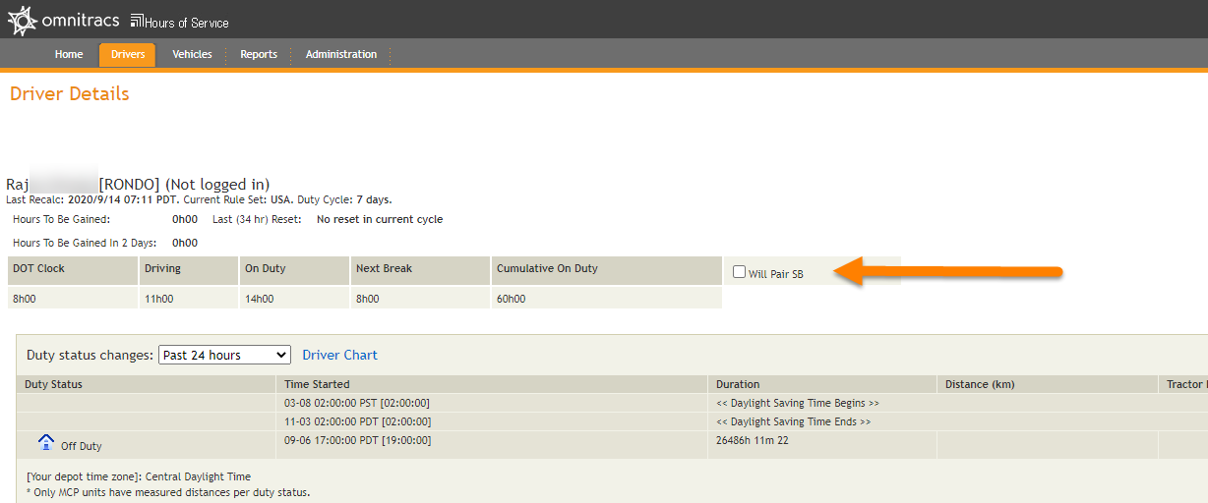
5.13 – New Hours of Service Rules Patch Host
Release Date September 26th in USA & Canada
Features
The will pair SB check box will recalculate all the drivers’ available hours as if they wanted to utilize the split sleeper.
This has no impact on drivers logs in the truck it simply allows users to see available hours if utilizing sleeper berth Regulations in Canada or the USA
Notes:
This was covered in Outlook HOS Basics

Slide 11
Mobile Releases

Slide 12
Mobile Release Dates
Dates for ES Mobile Products
Over the air upgrade availability dates:
IVG DA1007R September 8th
MCP 200/110 AA1831R August 2020
MCP 50 CA1397R September 21st

Slide 13
Mobile Release(s) FMCSA Changes on all releases
Sleeper Berth Changes
U.S. Federal Rules now allow drivers to split their 10-hour reset in two periods, as long as one off-duty period (whether in or out of the sleeper berth) is at least two hours long and the other is at least seven consecutive hours spent in the sleeper berth. Neither qualifying period will count against the 14-hour duty clock.
The Passenger Rule will allow a co-driver to take a combination of Sleeper Berth time of at least seven consecutive hours and up to three hours riding in the passenger seat of a moving vehicle, either immediately before or after the Sleeper Berth time, amounting to at least 10 consecutive hours.
While the co-driver is still off-duty, the Change Status screen will remind the driver that the sleeper berth is required.

Slide 14
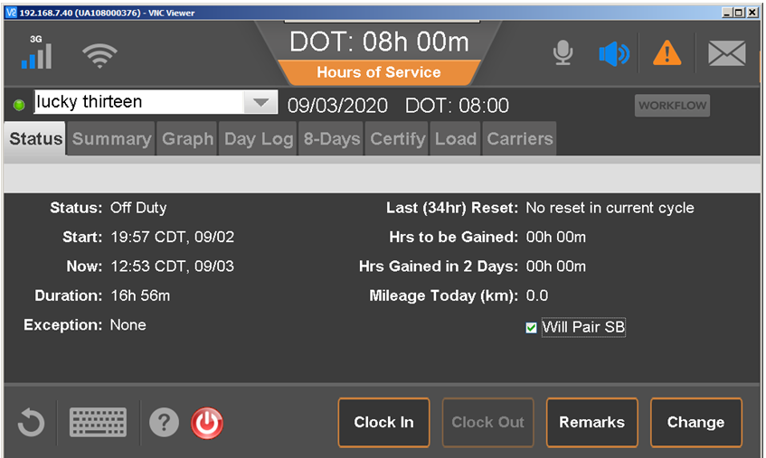
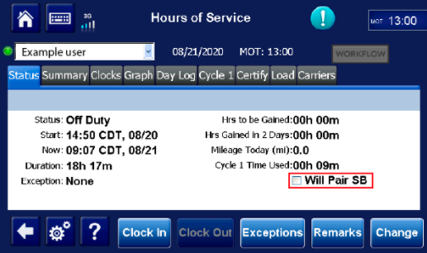
Mobile Release(s) FMCSA Changes on all releases
Sleeper Berth Changes
The Will Pair SB check box is now on the Status tab US and Canadian drivers can now identify if they intend to spit sleeper
Checked = This will calculate their available hours using an optimistic clock utilizing Sleeper berth rules and not counting the qualifying SB/off duty periods against their 14 hours.
Unchecked= The pessimistic clock that says the driver has no plans to pair a qualifying off-duty/sleeper period taken later, in which case the period counts against the 14.

Slide 15
Mobile Release New Features Common on all releases
Rest Break
Drivers will only be required to take the rest break after eight cumulative hours of driving, and take their 30-minute rest break while they are in any duty status other than Drive.
The qualifying 30-minute rest break can be a combination of any duty status other than Drive.
Personal Conveyance and Yard Move will also qualify toward the rest break.
When the driver is not in a driving status, a warning will appear on the Change Status screen when the rest break clock has two hours or less remaining, to advise the driver how much additional time is required, before they complete their 30-minute rest break.

Slide 16
FMCSA Release Known Issue Introduced
Split Sleeper no longer granted after the driver violates the Hours of Service Rules
The recent mobile and Host changes were made for the pending FMCSA Hours of Service changes included a change that will no longer grant the split sleeper pairing if the driver were to go into violation before the 2nd portion of the split.
Omnitracs has received clarification that the split sleeper methodology will not be changing. Omnitracs will continue to upgrade the mobile devices in preparation for the upcoming Hours of Service changes. A patch to the host and mobile will be implemented as soon as possible to support granting the Split Sleeper pairing after an hours of service violation.
To provide clarity this impact only drivers who have violated the Hours of Service rules and will not update their clocks until the satisfy 10 consecutive hours off.

Slide 17
Known Issue Introduced
Split Sleeper no longer granted after the driver violates the Hours of Service Rules
Impacted Firmware AA1831, CA1397R and DA1007R
5.13 Patch Host release completed August 29th contained the same rules engine issue as the mobile firmware listed above. This means the mobile units that have not upgraded will grant the split sleeper while the host will not, this will result in a mismatch between the host and mobile.

Slide 18
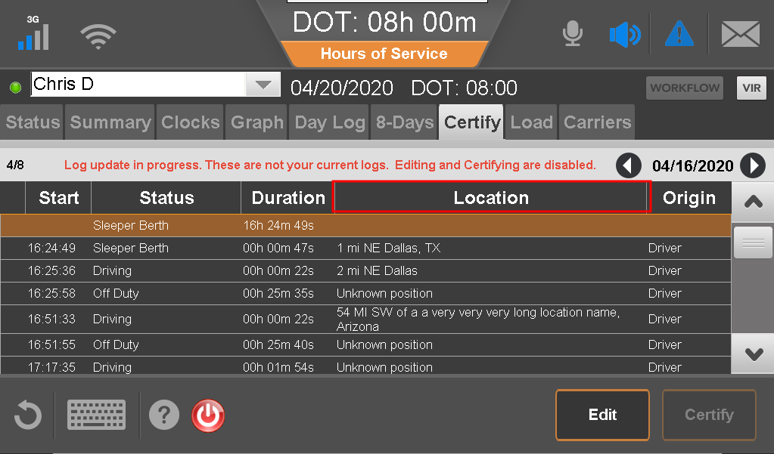
Feature Changes on all Mobile Releases
Certify Tab
The Certify tab now includes a Location column that shows the driver where the duty status occurred

Slide 19
Feature Changes on all Mobile Releases
Edit Yard Move & Personal Conveyance
Drivers can now edit Yard Move and Personal Conveyance statuses. They can change YM or PC to any other status including a non-driving status.
The active driver can now choose Drive status manually. This allows drivers to record their duty status accurately even if the ELD malfunctions.
The mobiles now identify manual driving versus automatically recorded driving to allow for editing of manually recorded driving on the host.
If a driver chooses to continue in Drive when no wheel movement is detected, the log will split the status, indicating when the automatic Drive status ended and the manual Drive status began.
Drivers now receive a confirmation message when they accept a UVA event. This means drivers can avoid accidentally accepting additional UVA events if they double-tap the Next button.

Slide 20
Bug Fixes
All Mobiles
All Firmware's will be posted with the FMCSA as Minimum requirement for ELD compliance moving forward
The engine hours field will no longer use a default number to occupy the data element field when it is missing or unavailable.
The host and mobile, townships and cities with a population of less than 5,000 people have been removed from the city database.
Some drivers were occasionally prompted to certify logs ending in the year 2043.
The header field in some ELD logs indicated that a Compliance Malfunction had occurred when there was no compliance malfunction event on that day.
ERODS transmitting with events with no User Information which are required for ERODS

Slide 21
Bug Fixes
All Mobiles
On rare occasions, eRODS files were missing intermediate logs.
On occasion the mobile device would use a manual VIN at start-up and an automatic VIN at shutdown. ERODS files treated the two VINs as two different vehicles, which caused problems with FMCSA interpretation of the ERODS file. This issue has been resolved; the mobiles now uses the last known valid VIN from the ECM.
Several changes have been made to ensure timing compliance malfunctions are recorded.

